Slide 1
Volume of Tetrahedron

Slide 2
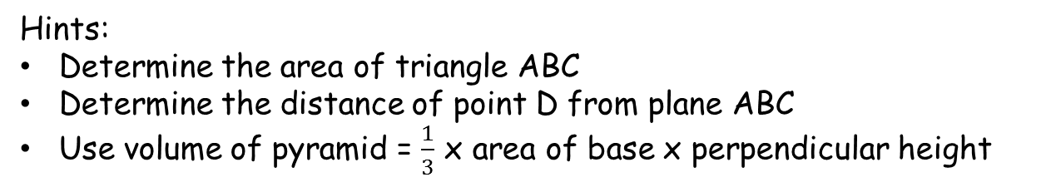
Volume of Tetrahedron
Hints:
Determine the area of triangle ABC
Determine the distance of point D from plane ABC
Use volume of pyramid = $\frac{1}{3}$ x area of base x perpendicular height

Slide 3
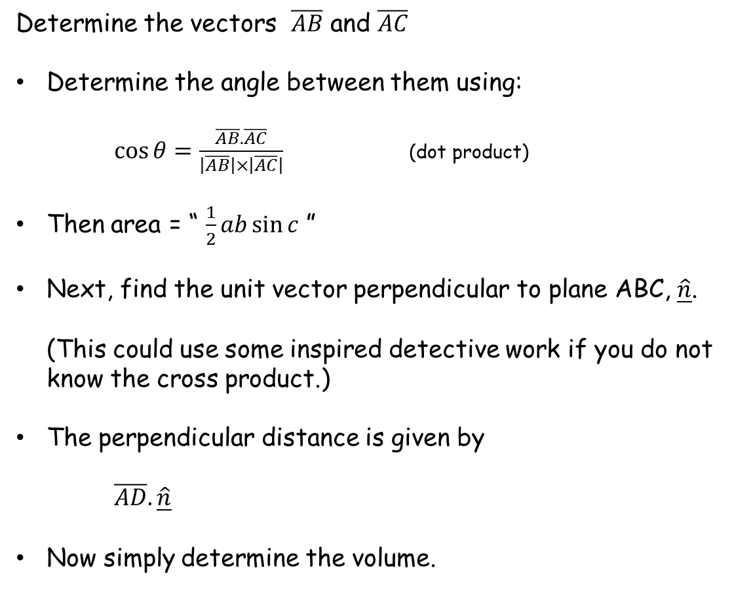
Determine the vectors $\overline{AB}$ and $\overline{AC}$
Determine the angle between them using: $\cos{θ=\frac{\overline{AB}.\overline{AC}}{\left|\overline{AB}\right|×\left|\overline{AC}\right|}}$ (dot product)
Then area = “ $\frac{1}{2}ab\sin{c}$ ”
Next, find the unit vector perpendicular to plane ABC, $\hat{\underline{n}}$. (This could use some inspired detective work if you do not know the cross product.)
The perpendicular distance is given by $\overline{AD}.\hat{\underline{n}}$
Now simply determine the volume.
D
C
A
B

Slide 4
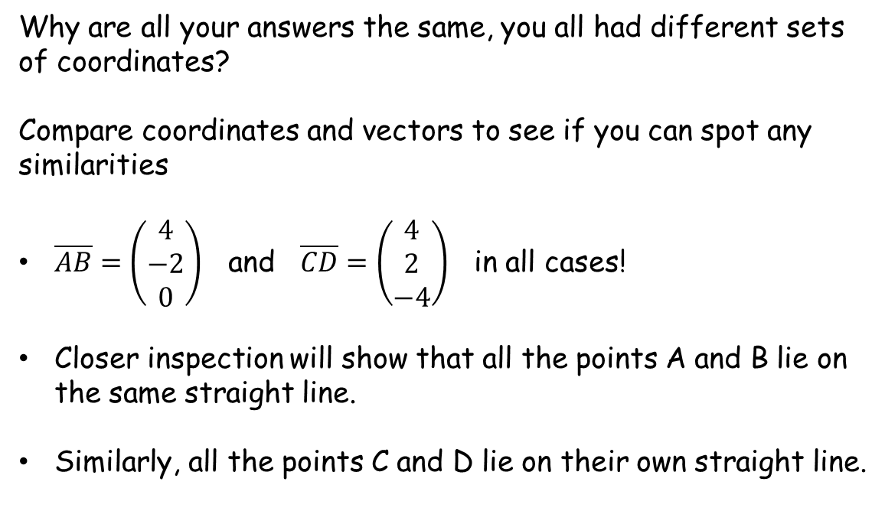
Why are all your answers the same, you all had different sets of coordinates?
Compare coordinates and vectors to see if you can spot any similarities
$\overline{AB}=\left(\begin{matrix}4 \\ −2 \\ 0\end{matrix}\right)$ and $\overline{CD}=\left(\begin{matrix}4 \\ 2 \\ −4\end{matrix}\right)$ in all cases!
Closer inspection will show that all the points A and B lie on the same straight line.
Similarly, all the points C and D lie on their own straight line.
D
C
A
B

Slide 5
This highlights the fact that if two line segments on different straight lines in 3D are connected to form a tetrahedron, the volume of the tetrahedron is invariant as the line segments slide along the lines.
D
C
A
B
Same volume
It’s analogous to these triangles having the same area

Slide 7
RESOURCES
The originals of the worksheets are in the spreadsheet
The Autograph files are for viewing in 3D

